Slide 1

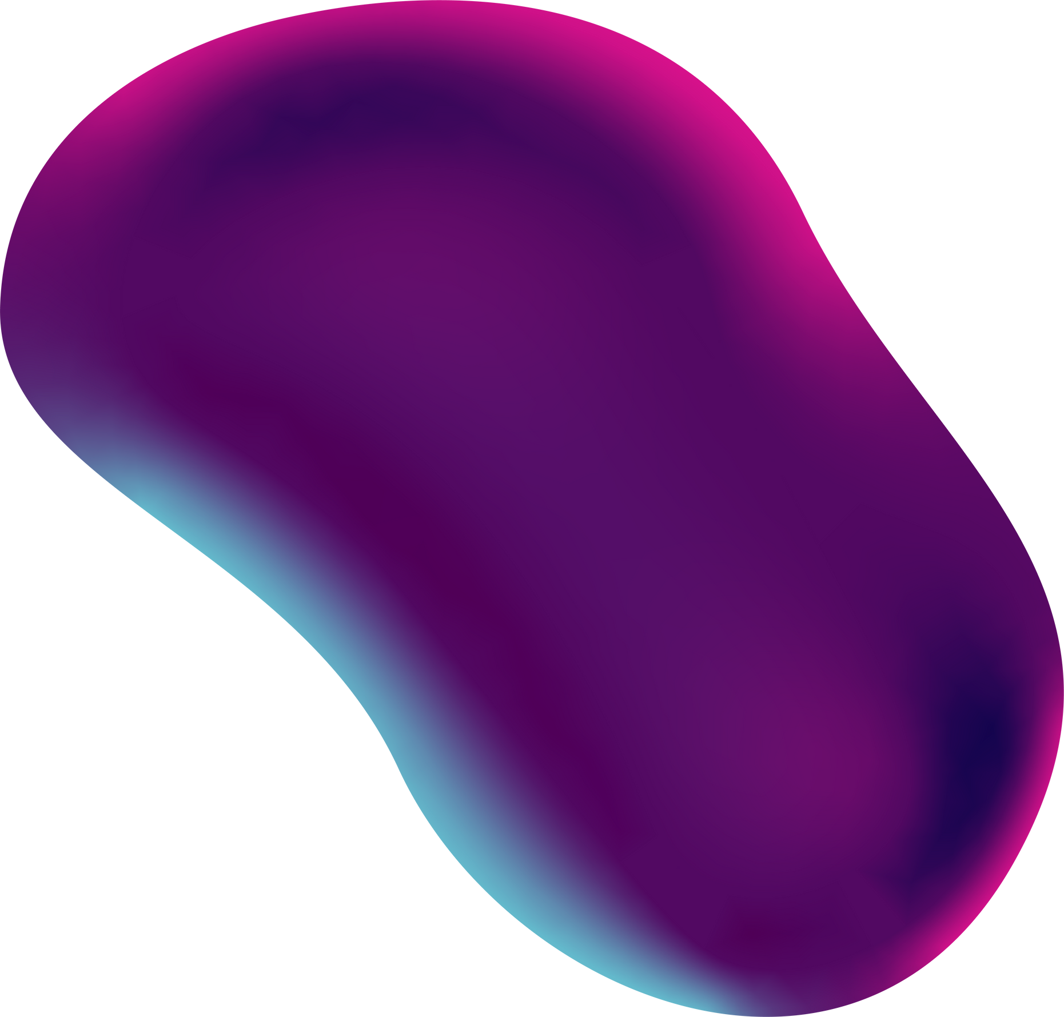
2019 - 2023
YEAR III - Quarter 3
CSE360 - CA4 PROJECT
Old Paintings Restoration
TEAM MEMBERS
Saai Swetha M K - E0119016
Niveditha B - E0119019
Swetha T - E0119034
Kathir Oli K - E0119066

Slide 2
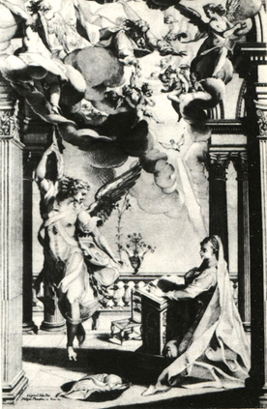
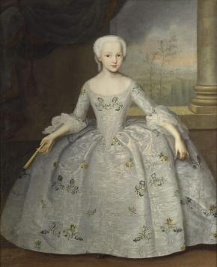
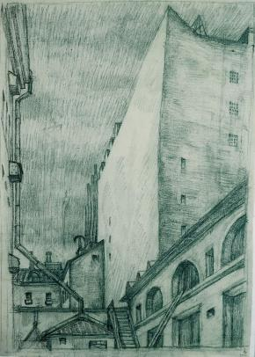
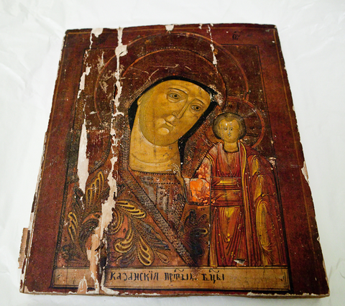
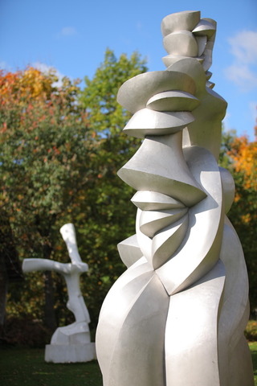
About the Data set
Classes:
Drawings and watercolours
Works of painting
Sculpture
Graphic Art
Iconography (old Russian art)
Data is separated on training and validation sets
Source: Kaggle
https://www.kaggle.com/thedownhill/art- images-drawings-painting-sculpture-engraving

Slide 3
Introduction
Black and white images can be represented in grids of pixels. Each pixel has a value that corresponds to its brightness. The values span from 0–255, from black to white.
A neural network creates a relationship between an input value and output value. To be more precise with our colorization task
the network needs to find the traits that link grayscale images with colored ones to reconstruct old grey images to colored ones.

Slide 4

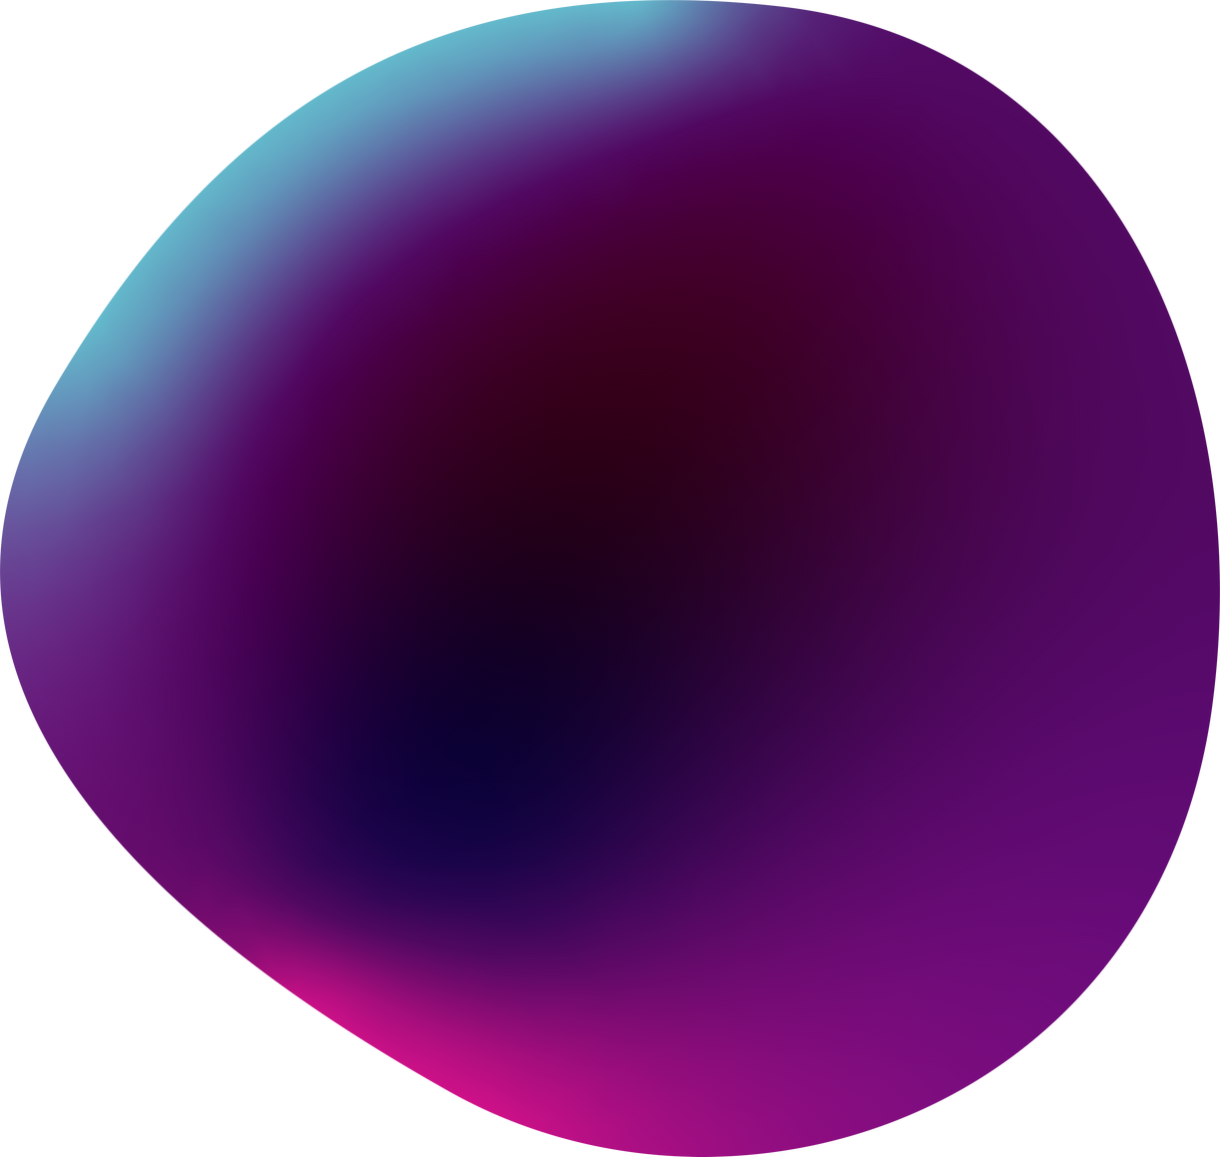
Problem Statement
Old art images were produced during early times so it is subject to a lot of noise.
Thus while converting them to digitalized colored images. We need to remove the noise before coloring them.

Slide 5
Models Information
Image Classification : CNN
Image Colorization : Inception ResNet v2
Denoising and Reconstruction Models:
Vanilla Autoencoder
Sparse Autoencoder
Deep Autoencoder

Slide 6
Autoencoders
Dimentionality reduction technique
Non-Linear Transformation
PSNR : Peak Signal-to-Noisy Ratio
To measure the quality of reconstruction of lossy compression

Slide 7
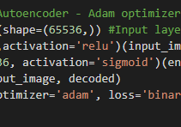
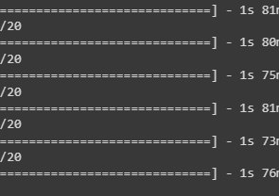
Denoise-Vanilla Encoder
Model 1
Model 2
Adam optimizer and Binary Crossentropy as loss parameter
sgd optimizer and early_stop callback
Model 3
Model 4
Adam optimizer and Binary Crossentropy as loss parameter and early_stop callback
Adam optimizer and mse as loss parameter and early_stop callback

Slide 8
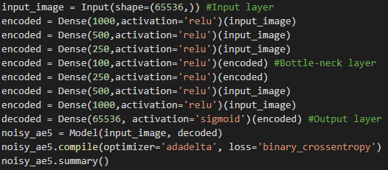
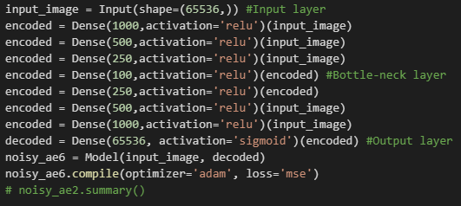
Denoise-Deep Autoencoders
Model 5
Model 6
Deep Autoencoders using 'adadelta' optimizer and 'binary_crossentropy' as loss parameter
Adam optimizer and Mean Squared Error as loss

Slide 9
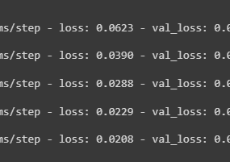
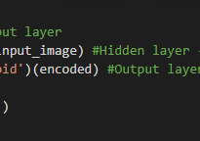
Reconstruct-Vanilla Autoencoder
Model 7
Model 8
using 'binary_crossentroy' as loss prameter
using 'mse' as loss parameter

Slide 10
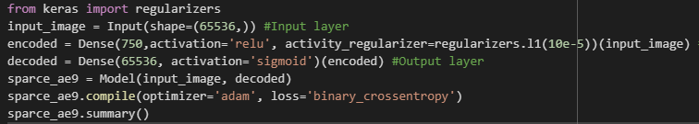
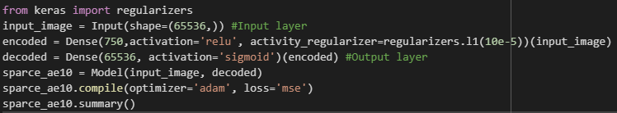
Reconstruct-Sparse Autoencoder
Model 9
'sparce_ae' using 'binary_crossentroy' as loss prameter
Model 10
'sparce_ae2' using 'mse' as loss parameter

Slide 11
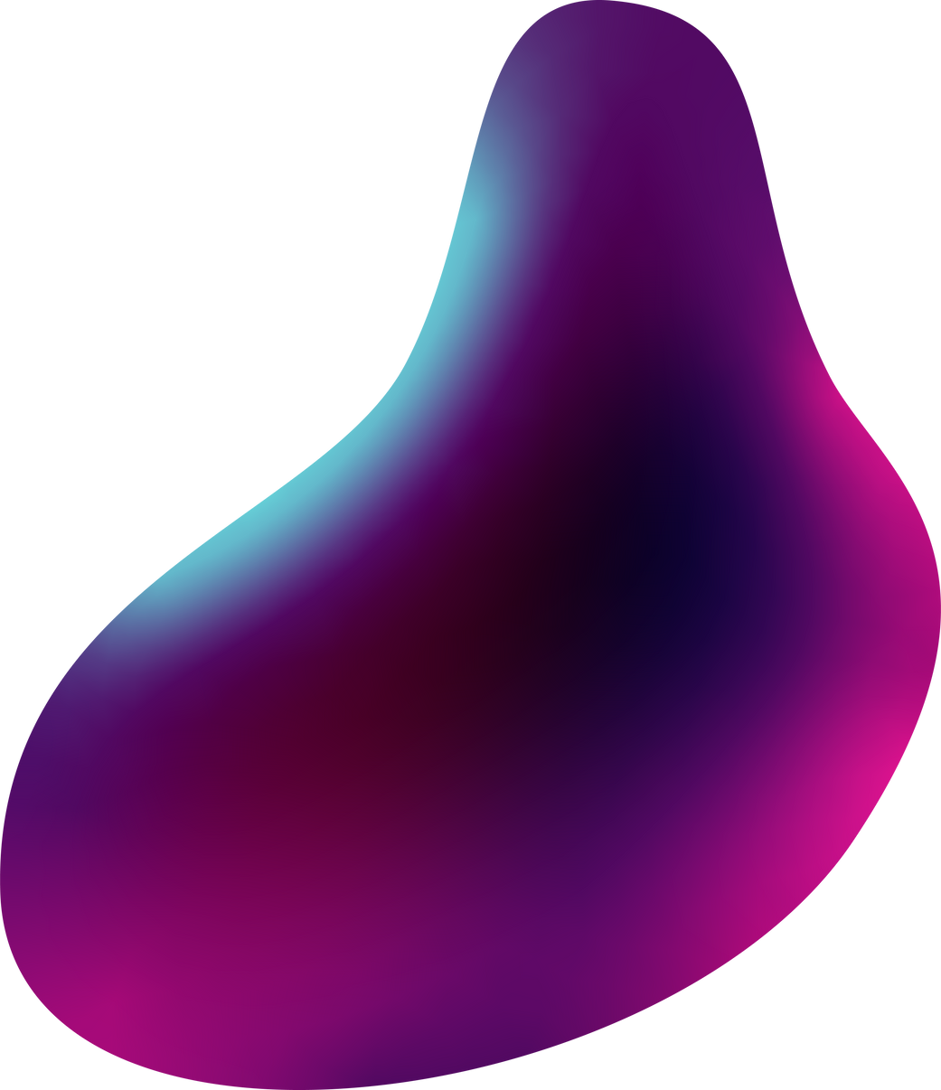
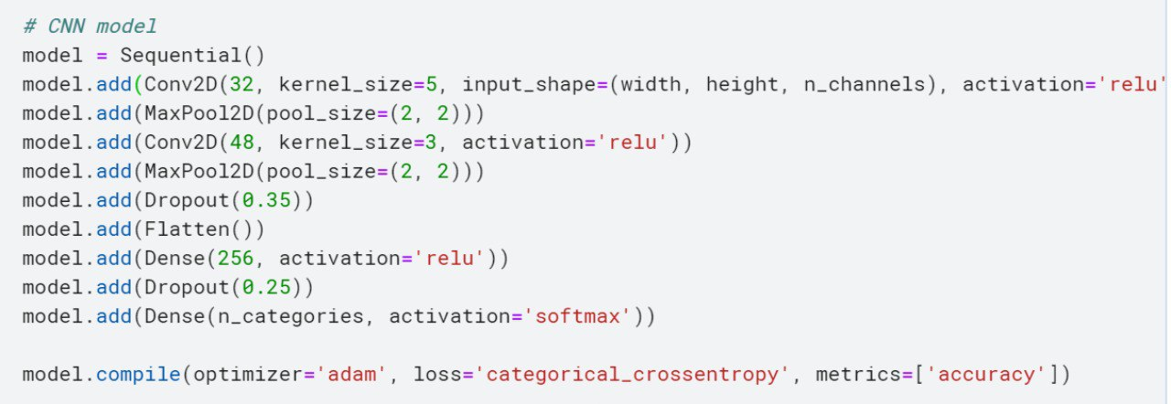
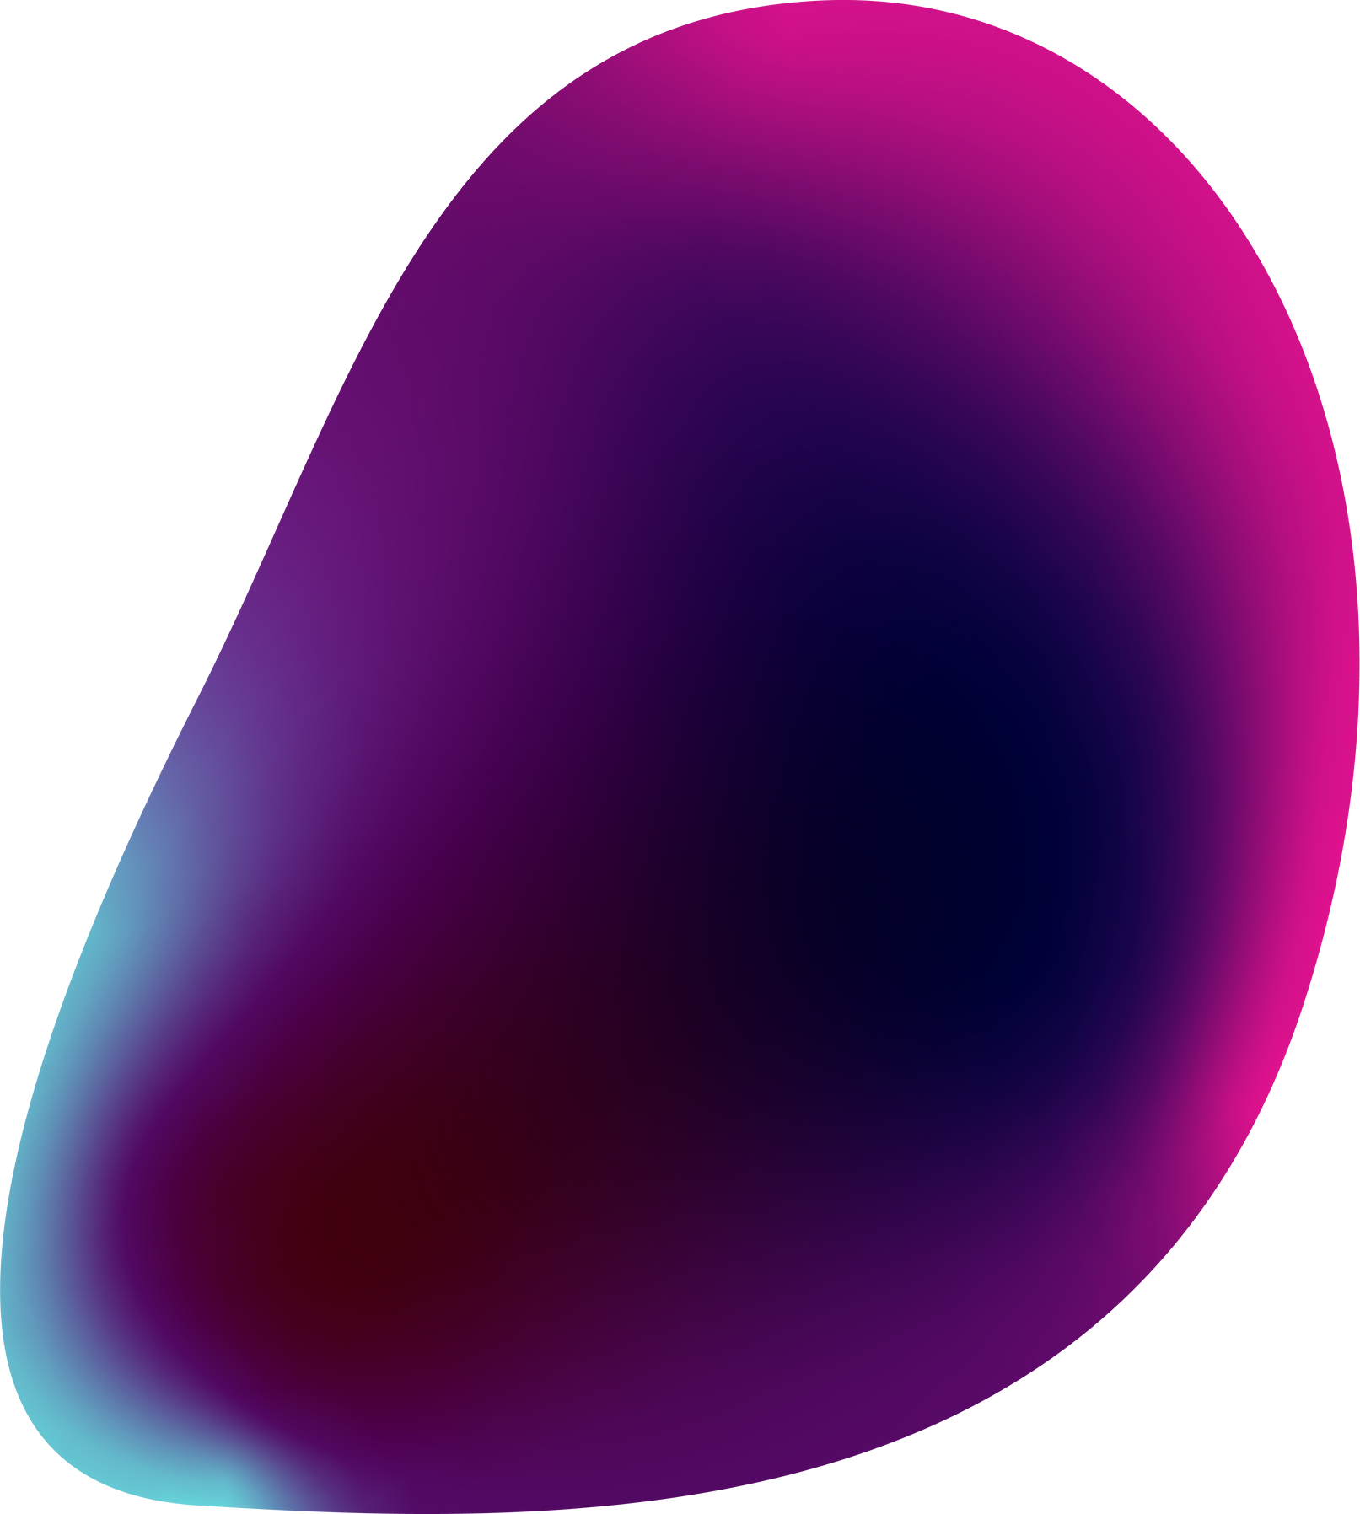
Classification Model
Classes in dataset:
Drawings and watercolours
Works of painting
Sculpture
Graphic Art
Iconography (old Russian art)
Classify pictures into these 5 major art categories with a CNN model.
Images were augmented using parameters like
rotation_range
zoom_range
horizontal_flip
Implemented multiclass classification using a CNN model

Slide 12

Colorization
First, we’ll use an algorithm to change the color channels, from RGB to Lab.
L stands for lightness
a for the green–red spectra
b for the blue–yellow spectra
To turn one layer into two layers, we use convolutional filters.

Slide 13
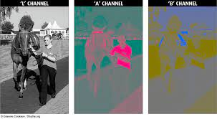
Lab visualization
94% of the cells in our eyes determine brightness. That leaves only 6% of our receptors to act as sensors for colors.

Slide 14
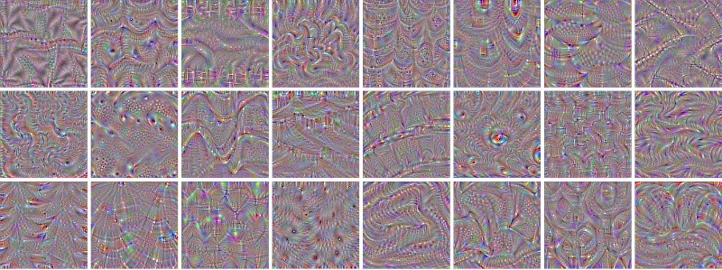
Filtering images
3x3 filter is used to get simple patterns

Slide 15
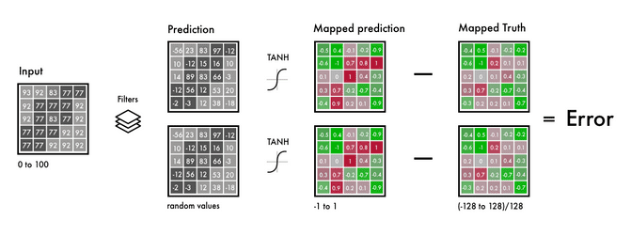
The B&W input, our filters, and the prediction
Normalize true color values by dividing all by 128 to bound the range between -1 and 1.

Slide 16
Possible Improvements to the model
Implement it with another pre-trained model
Try a different dataset
Increase the network’s accuracy by using more pictures
Build an amplifier within the RGB color space. Create a similar model to the coloring network, that takes a saturated colored image as input and the correct colored image as output.
Implement a weighted classification

Slide 17
Conclusion
This project validates that an end-to-end deep learning architecture could be
suitable for some image colorization tasks. Our approach is able to
successfully color low-level image components .

Slide 18
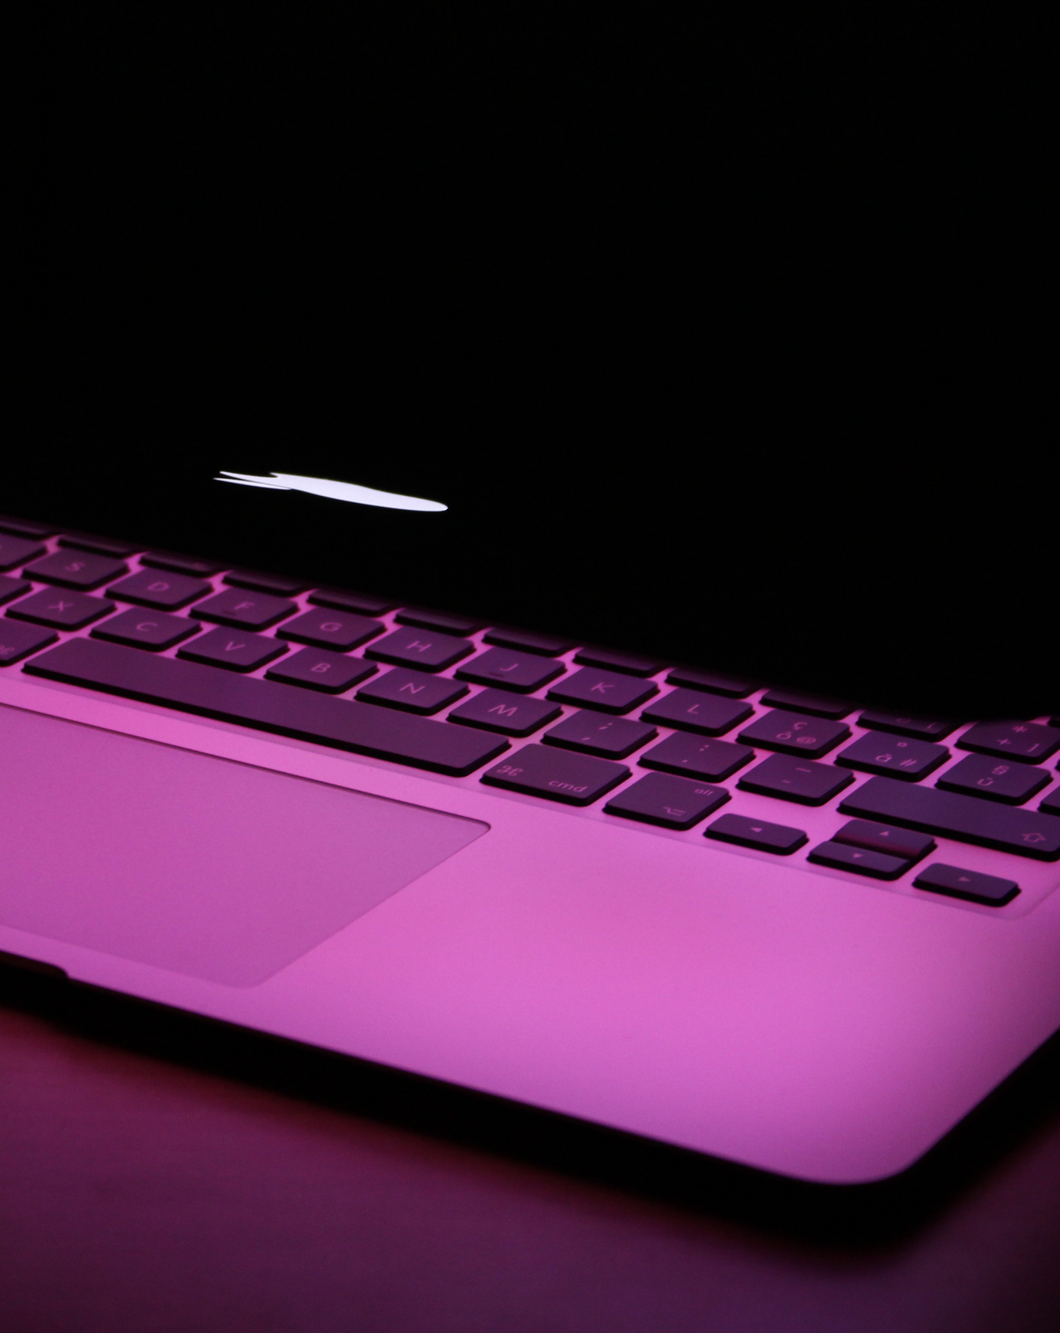
Deploy
In 2002, Welsh et. al. presented a novel approach which was able to colorize an input image by transferring the color from a related reference image. Subsequent improvements of this method were proposed, exploiting low-level features and introducing multi-modality on the pixel color values.

Slide 19
Lit Review
A research line was initiated in 2004 by Levin et. al., who proposed a scribble based method which required the user to specify the colors of few image regions. This colorization methodology woke the interest of animators and cartoon-aimed techniques were proposed. The results from these approaches were certainly impressive at that time.
Draw Backs
The results were highly dependent on the artistic skills of the user. More recently, automatized approaches have been proposed.
users need to be very careful when choosing the colors and strokes’ positions

Slide 20
Thank You

